Slide 1
Group project: House price prediction
Boris Korotkov
Robert Shaheen
Vladimir Taubes
SCS_3253_009 Machine Learning

Slide 2
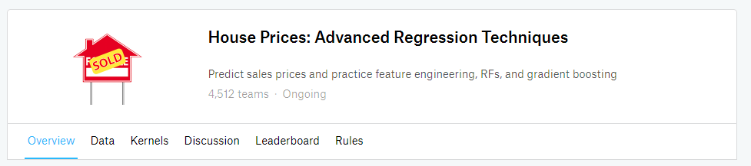
Data source: ongoing Kaggle competition
There are 79 explanatory variables, 1460 rows in train dataset and 1459 rows in test dataset

Slide 3
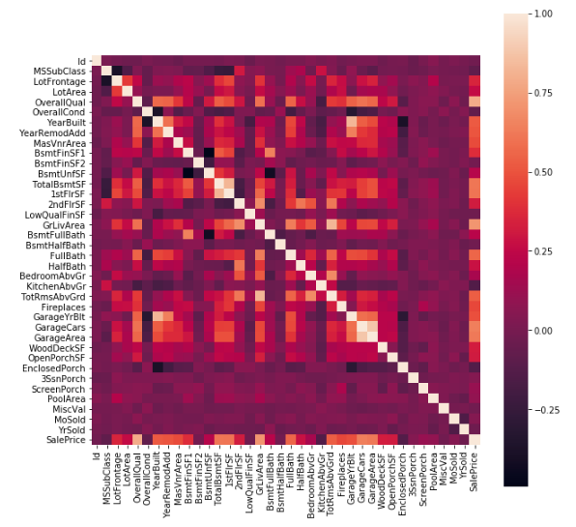
Data descriptive analysis
Numeric columns correlation

Slide 4
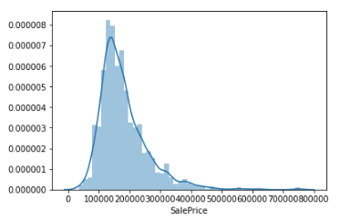
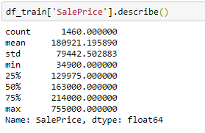
Data descriptive analysis (cont.)
Sales price distribution

Slide 5
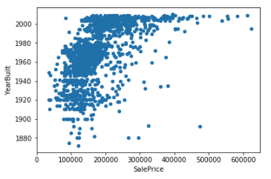
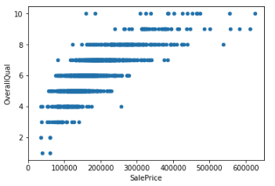
Data descriptive analysis (cont.)
Sales price over year built and over house quality

Slide 6
Data preparation
New features added:
Years between renovation and sold date
Above ground living area over Lot area
Above ground living area over number of bedrooms
Overall quality over Overall condition

Slide 7
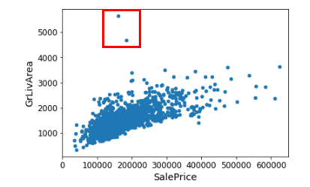
Data preparation (cont.)
We noticed that source data has some significant outliers and removed two data point from the training dataset to increase accuracy of prediction.

Slide 8
Data preparation (cont.)
Data transformation of numerical and categorical features using:
  Pipeline
  SimpleImputer
  MinMaxScaler
  OneHotEncoder
The feature number after transformation grew up from 79 to 291

Slide 9
Base model selection
The following regression models have been selected for initial assessment:
Linear Regression
SVR
Ridge
Lasso
ElasticNet
SGDRegressor
KNeighbors Regressor
Decision Tree Regressor
Random Forest Regressor

Slide 10
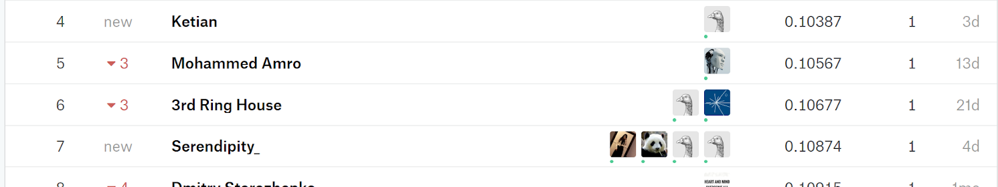
Performance Metric
RSME(log(SalePrice), log(predicted SalePrice))

Slide 11
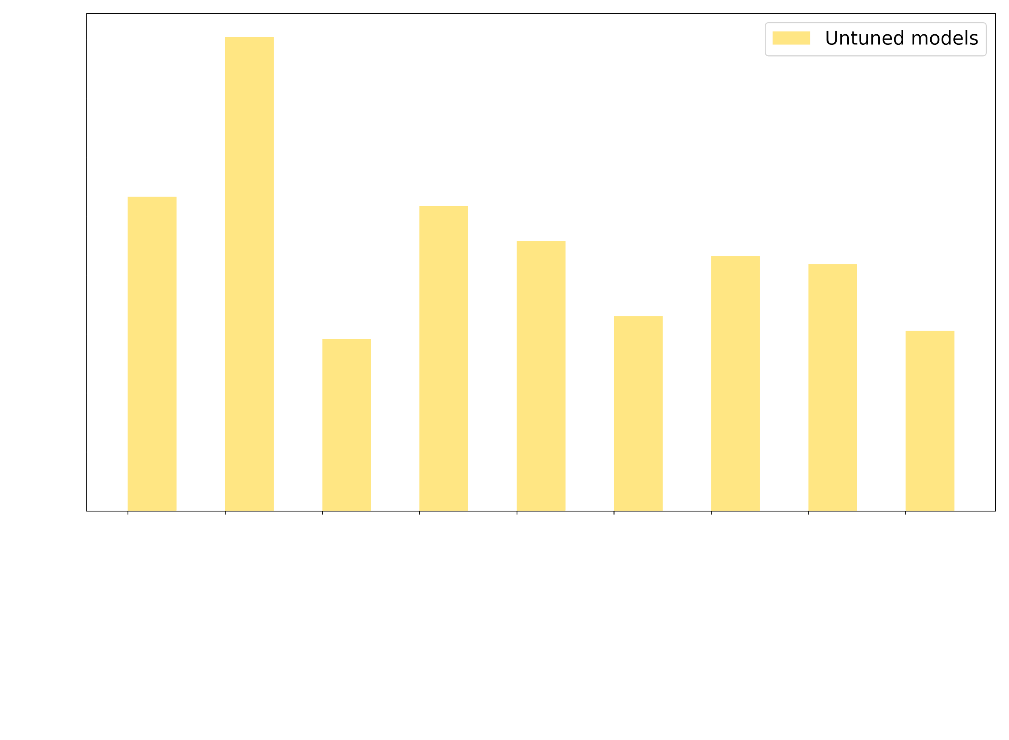
RMSE untuned models

Slide 12
Tuning hyperparameters
Model name (sklearn) | Tuned hyperparameters
LinearRegression | {'fit_intercept': True}
SVR | {'max_depth': 16, 'max_features': 125, 'min_samples_leaf': 2, 'min_samples_split': 2, 'n_estimators': 1000}
Ridge | {'alpha': 1.0, 'fit_intercept': True, 'solver': 'auto'}
Lasso | {'alpha': 71, 'max_iter': 100}
ElasticNet | {'alpha': 100, 'l1_ratio': 1.0}
SGDRegressor | {'eta0': 0.001, 'learning_rate': 'constant', 'loss': 'squared_epsilon_insensitive', 'max_iter': 50, 'penalty': 'none', 'power_t': 0.5}
K-Neighbours Regressor | {'algorithm': 'auto', 'n_neighbors': 7, 'p': 1, 'weights': 'distance'}
Decision Tree Regressor | {'max_depth': 9, 'max_features': 'auto', 'max_leaf_nodes': None, 'min_samples_leaf': 2, 'min_samples_split': 18}
Random Forest Regressor | {'max_depth': 16, 'max_features': 125, 'min_samples_leaf': 2, 'min_samples_split': 2, 'n_estimators': 1000}

Slide 13
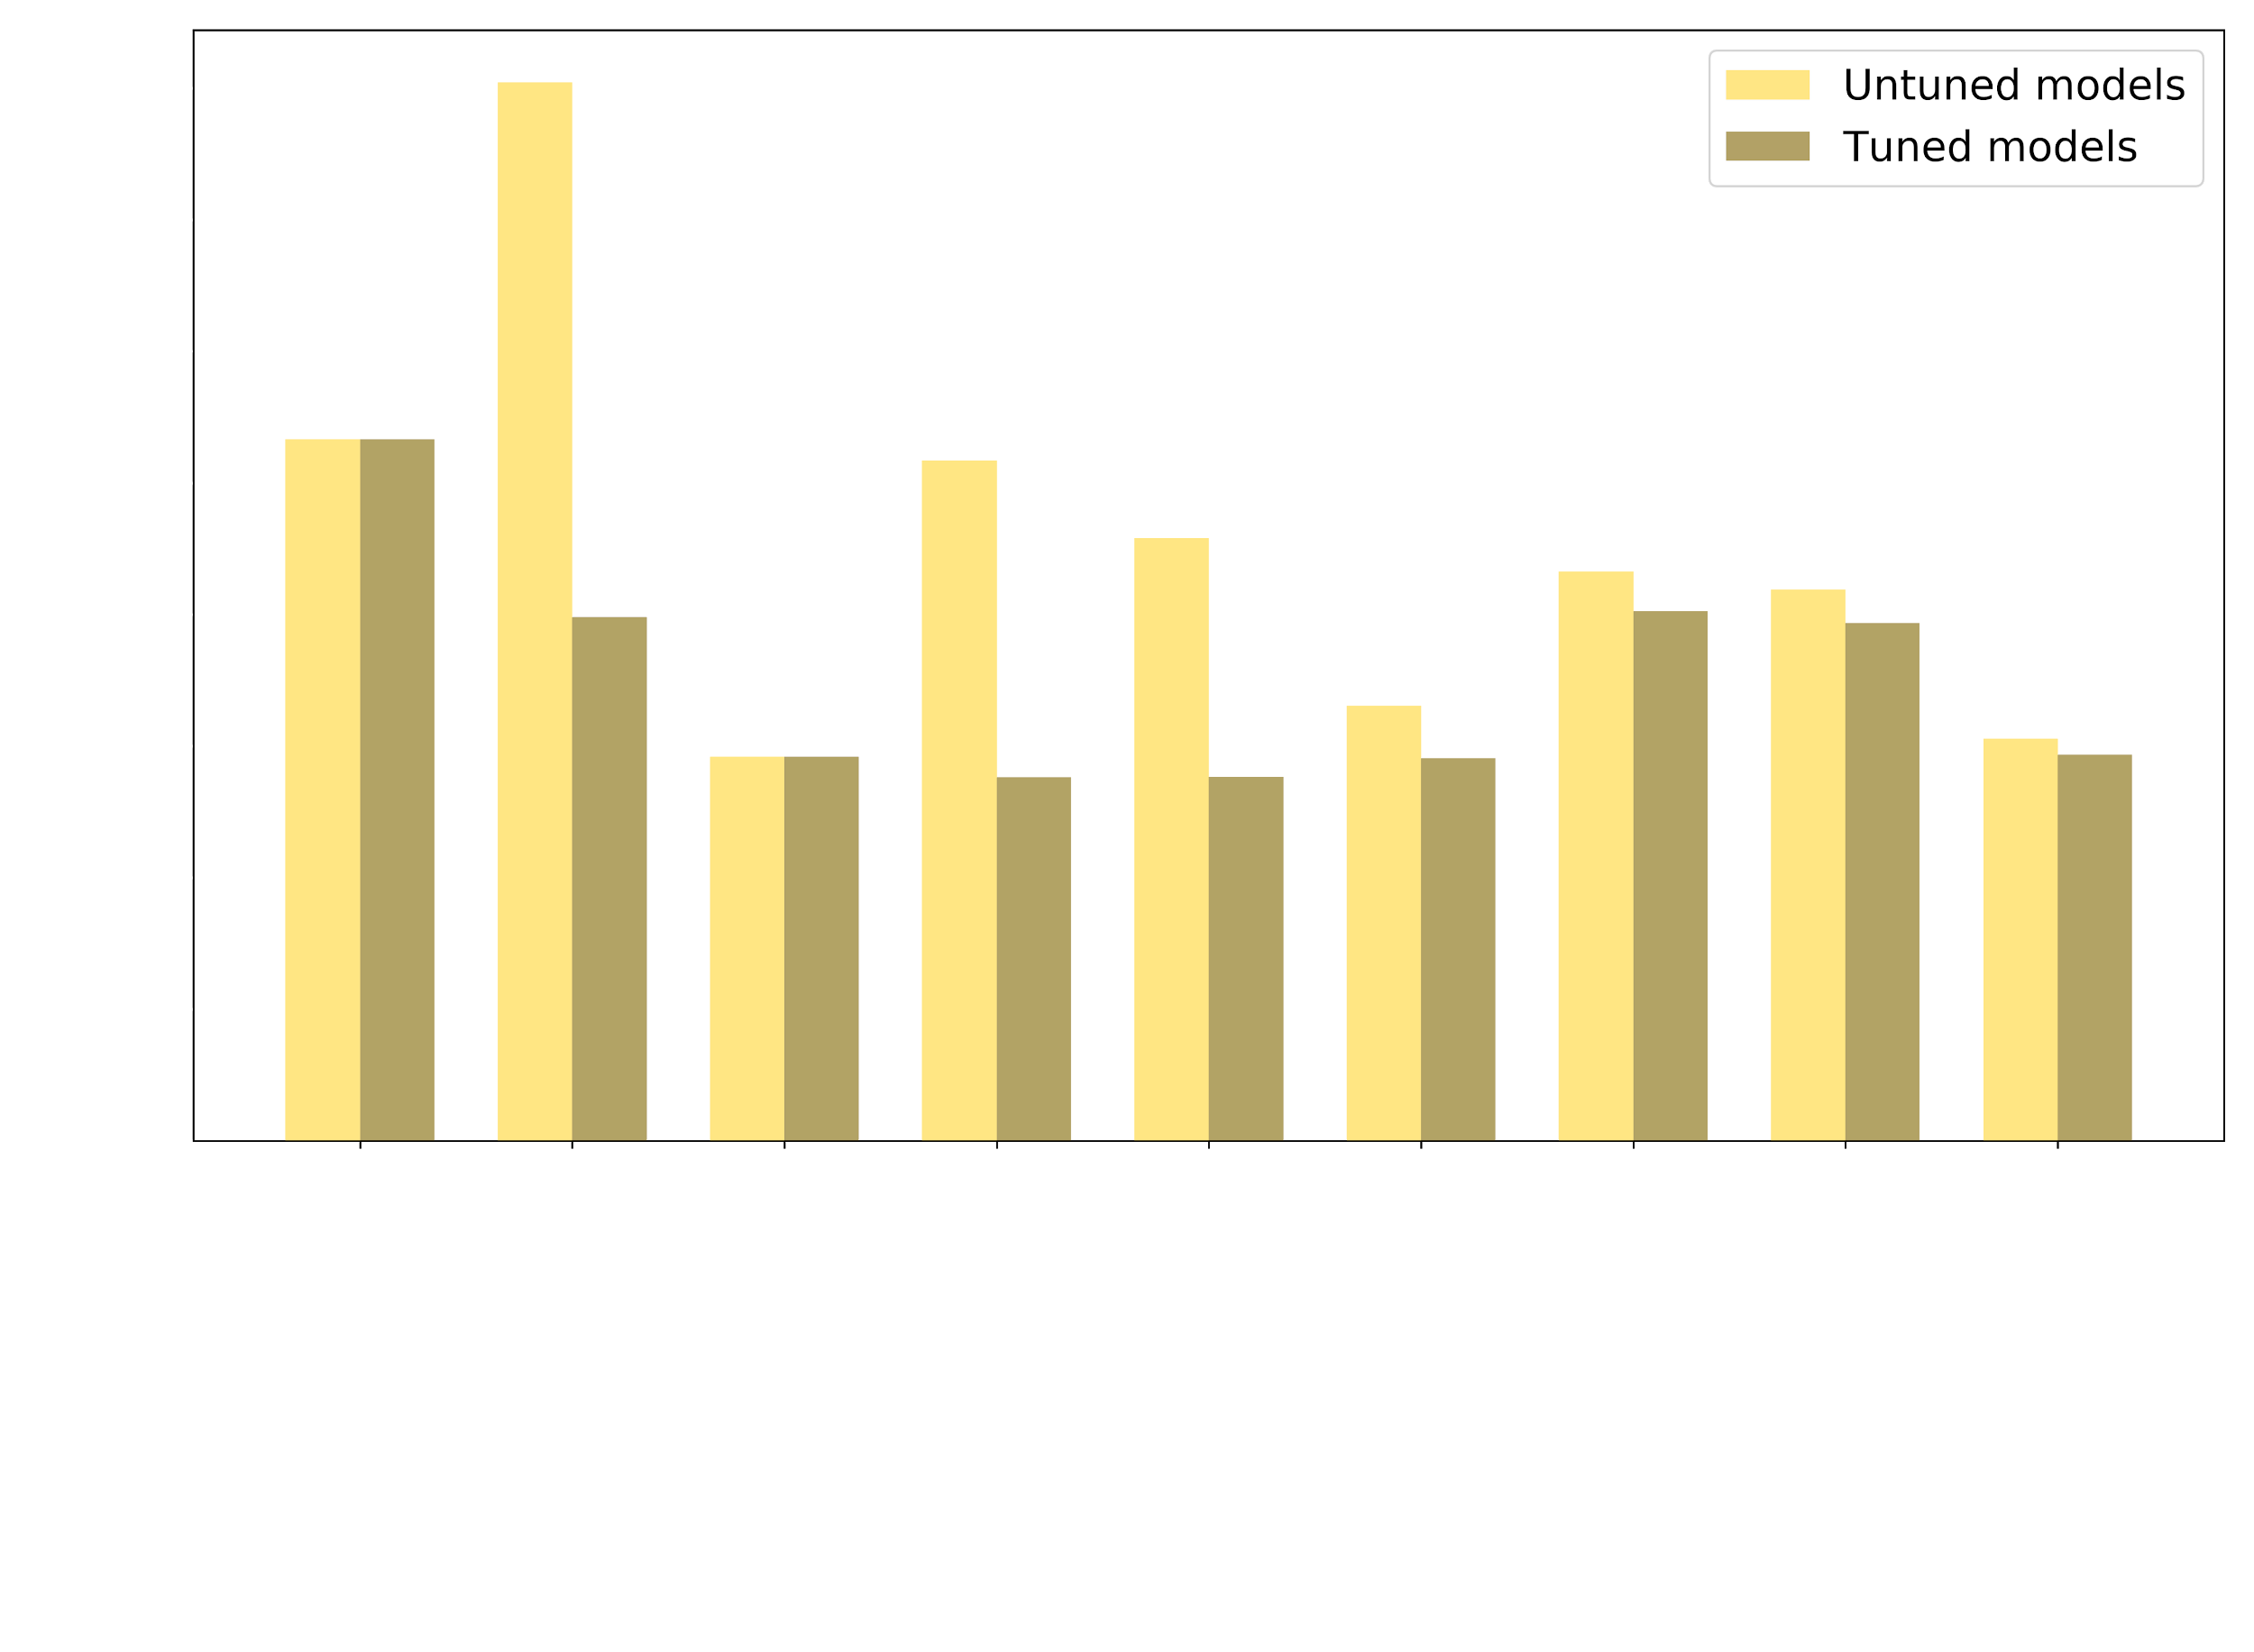
RMSE tuned models

Slide 14
RMSE tuned models
Model name (sklearn) | Untuned RMSE | Tuned RMSE | Performance Increase | Untuned r2 | Tuned r2
LinearRegression | 0.26636 | 0.26639 | 0.00% | 0.57903 | 0.87793
SVR | 0.40208 | 0.19893 | ⇮50.53% | 0.04099 | 0.74334
Ridge | 0.14586 | 0.14586 | 0.00% | 0.87380 | 0.89722
Lasso | 0.25845 | 0.13809 | ⇮46.57% | 0.60378 | 0.90787
ElasticNet | 0.22906 | 0.13824 | ⇮39.65% | 0.68876 | 0.90916
SGDRegressor | 0.16523 | 0.14529 | ⇑12.07% | 0.83804 | 0.89647
K-Neighbours Regressor | 0.21635 | 0.20128 | ⇑6.96% | 0.72234 | 0.78280
Decision Tree Regressor | 0.20935 | 0.19671 | ⇑6.04% | 0.74002 | 0.76758
Random Forest Regressor | 0.15267 | 0.14660 | ⇑3.98% | 0.86175 | 0.90821

Slide 15
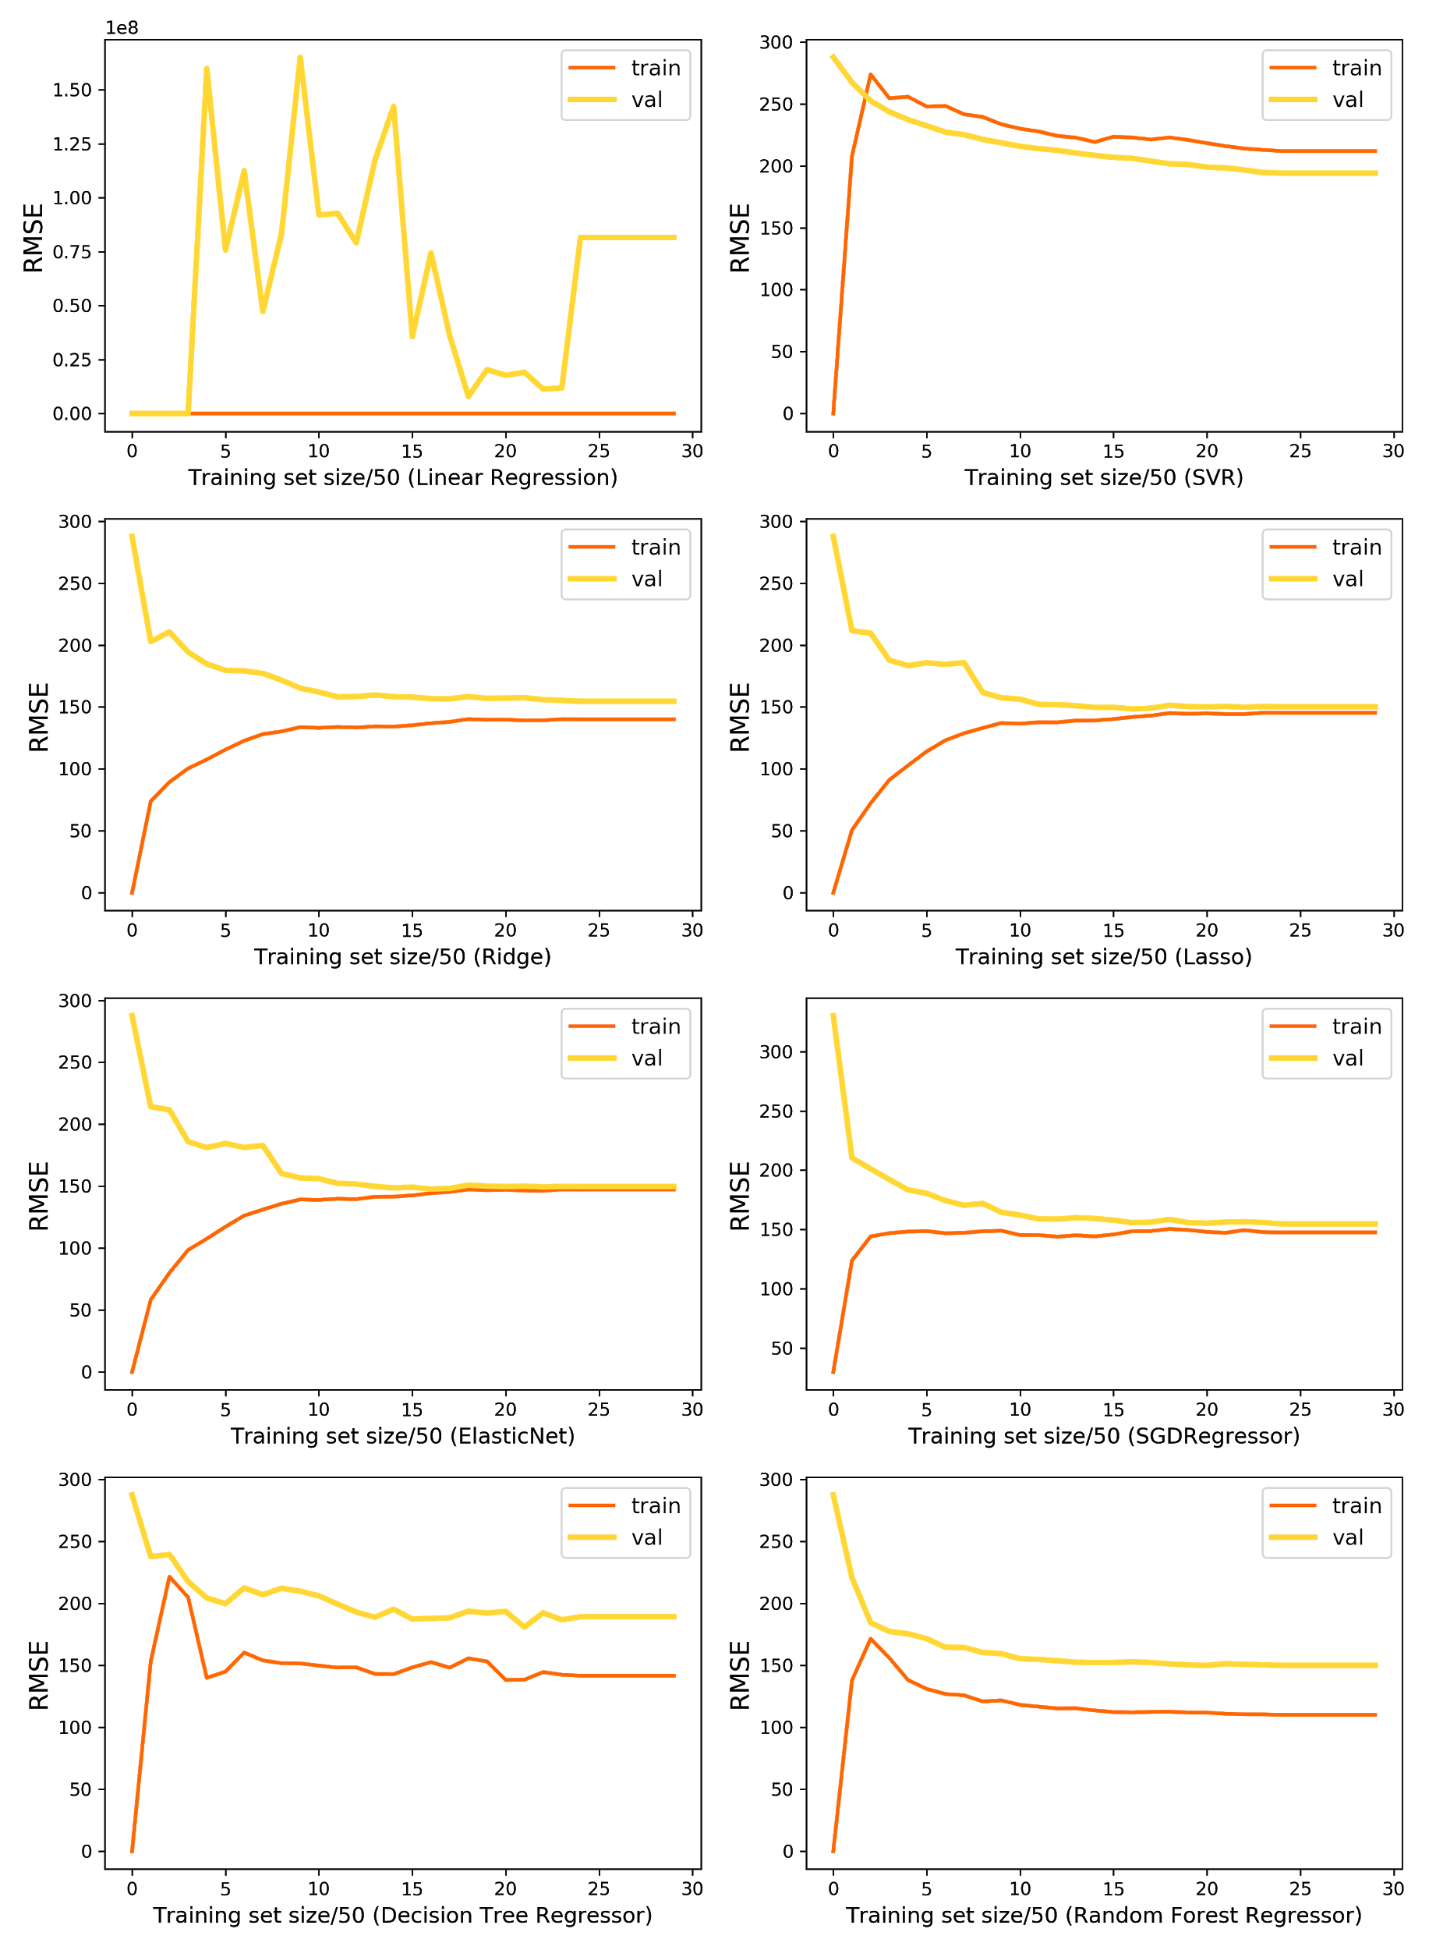
Learning curves for select tuned models

Slide 16
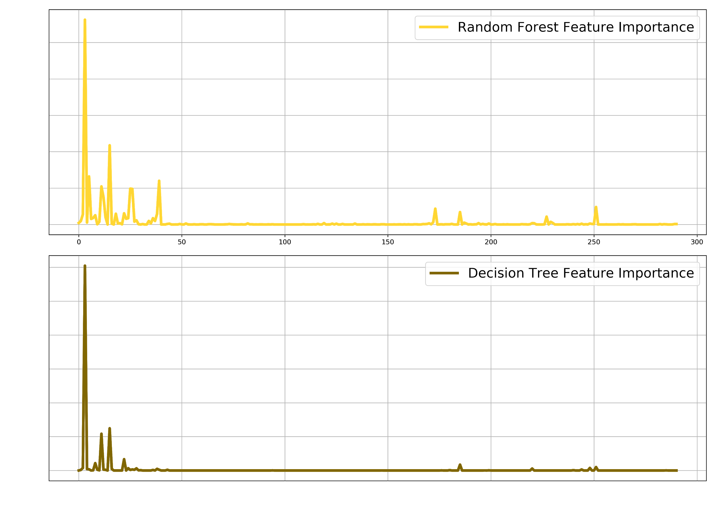
Feature importance
Most important feature: LotArea

Slide 17
Aggregate Learning
The following models were selected for ensemble learning:
Bagging Regressor
Gradient Boosting Regressor
Stacking

Slide 18
Bagging Regressor
Model name (sklearn) | Tuned hyperparameters
BaggingRegressor | {'base_estimator': SVR(C=113564, cache_size=200, coef0=0.0, degree=3, epsilon=0.1, gamma=0.0007790692366582295, kernel='rbf', max_iter=-1, shrinking=True, tol=0.001, verbose=False), 'bootstrap': True, 'max_features': 1.0, ‘max_samples': 1.0, 'n_estimators': 7}
Model name (sklearn) | Tuned RMSE | Tuned r2
BaggingRegressor | 0.19855 | 0.74745
⇩43.8%

Slide 19
Gradient Boosting Regressor
Model name (sklearn) | Tuned hyperparameters
GradientBoostingRegressor | {'learning_rate': 0.1, 'max_depth': 6, 'max_features': 'auto', 'max_leaf_nodes': 10, 'min_samples_leaf': 2, 'min_samples_split': 50, 'n_estimators': 300, 'subsample': 0.9, 'warm_start': True}
Model name (sklearn) | Tuned RMSE | Tuned r2
GradientBoostingRegressor | 0.11468 | 0.91971
⇧17.0%

Slide 20
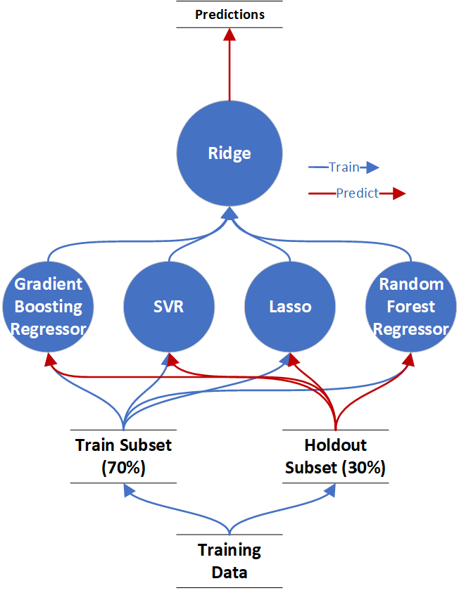
Stacking Regressor
Model name (sklearn) | Tuned RMSE | Tuned r2
GradientBoostingRegressor | 0.11468 | 0.91971
⇧17.1%

Slide 21
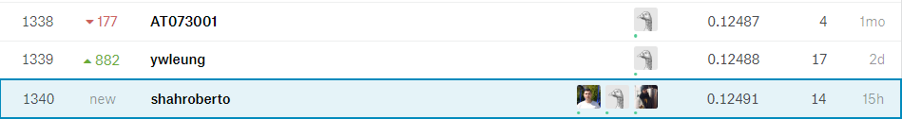
Competition Public Leaderboard
The Neural network was used for final prediction using test dataset and the result was submitted to Kaggle public leaderboard.
The submission rank was 1340 out of 4,632, top 28.9%. Not bad!
The top 10 score was about 0.11

Slide 22
Questions?

